Slide 1
Automated Testing
Notes:
PROFSWD Lesson
1. Coded UI Test - Need to find a website to test on = SpringAir! :-)
- Add Data
- fdsfs
2. Slides/Pointers on what I expect for CO3 next week
3. How to use GIT commandline tools or clone GIT repository on VSONLINE to github
4. Install local SQLServer

Slide 2
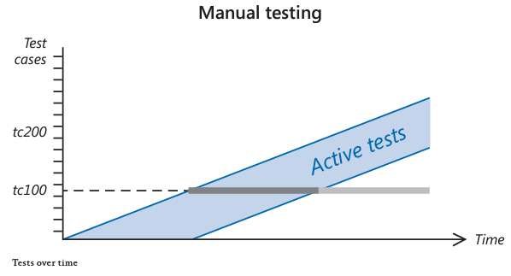
Notes:
To make matters worse, as time goes on, you accumulate more functionality, so there are more features to test. You only have limited testing resources. Naturally, you only test the features that have most recently been developed. A graph over time in which test cases are listed on the vertical axis would look like this

Slide 3


Slide 4
How to Automate a Test
Code the Test Method (Use Coded UI Tests)
Link the Test Method to a Test Case
Setup a Test Plan for Automated Tests
Define the Build Workflow*

Slide 5
What’s Expected From CO3 Sprint 1 Demos
PowerPoint Slides
Visual Studio Online TaskBoard Screenshot
Screenshot of Test Manager with Completed tests
Demo of Sprint1 Website hosted on Azure

Slide 6
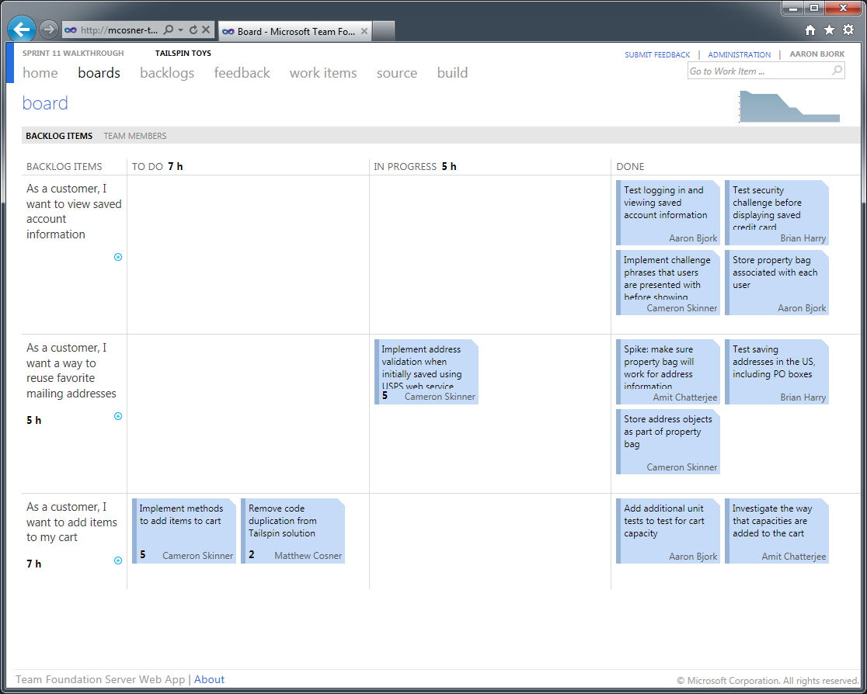
Sample Task Board Screenshot

Slide 7
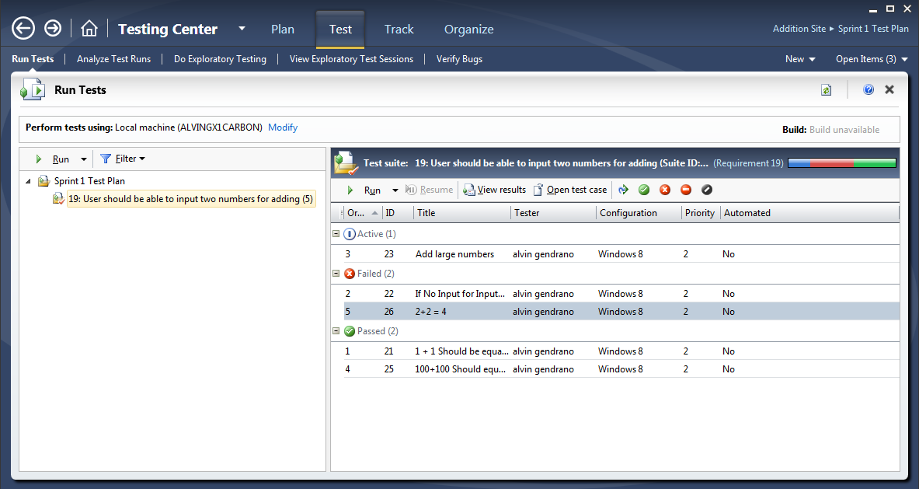
Sample Manual Test Runs Screenshot

